Slide 1
Serial RapidIO (SRIO) Subsystem

Slide 2
Agenda
SRIO Overview
DirectIO Operation
Message Passing Operation
Other RapidIO Features
Summary

Slide 3
SRIO Overview
SRIO Overview
DirectIO Operation
Message Passing Operation
Other RapidIO Features
Summary

Slide 4
Introduction To RapidIO
Two Basic Modes of Operation:
DirectIO
Read/write operations directed to specific memory address
Transmit device has knowledge of memory map of receiving device
Functional units:
LSU (Load/Store Unit)
MAU (Memory Access Unit)
Message Passing
Mailbox and Letter designators
Transmit device does not need knowledge of memory map of receiving device
Functional units:
TXU (Message Transmit Unit)
RXU (Message Receive Unit)
Data communication on differential input/output ports
Overall RapidIO architecture divided into three layers:
Physical Layer
SERDES
RapidIO Physical layer IP
Transport Layer
Transports packet from physical layer to logical layer protocol units
Logical Layer
Protocol Units (e.g. LSUs, TXU, etc.)

Slide 5

New Features Compared to C64x+
RapidIO 2.1.1 Compliant / RapidIO 1.2 Compliant
For ports with options show in the table below:
Data rates up to 5 Gbaud/ Data rates up to 3.125 Gbaud
Different ports at different baud rates (Only integer multiple different rates are allowed)
24 Interrupt outputs / 8 Interrupt outputs
1 MB LSU transaction size with queuing capability/ single 4 KB LSU transaction size
Type 9 Packet Support (Data Streaming)
External Type 9 and Type 11 queue management
Strict priority scheduler / Round-robin scheduler
Round robin interleaved on a packet basis at a given priority
Outbound credit-aware functional blocks
16 Local DeviceIDs & 8 Multicast IDs / 1 Local DeviceID & 3 Multicast IDs
Auto-promotion of response priorities by RXU and MAU can now be disabled
Ability to set the CRF (Critical Request Flow) bit on outgoing requests and responses
Physical Layer
Logical Layer

Slide 6
SRIO in KeyStone Devices
Data Interface
Just for muxing PCIe with SRIO
Message Passing & Type 9 Only
Configuration Interface
Memory Protection Unit

Slide 7
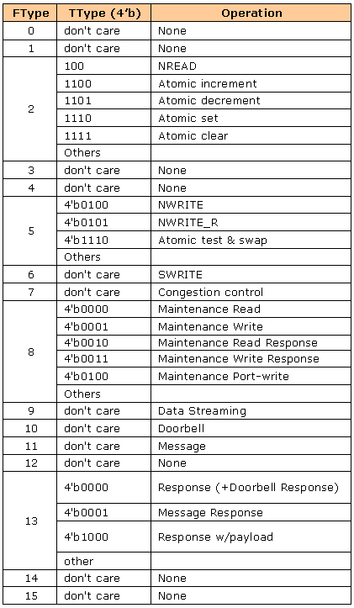
Packet Types
New Packet Type Supported in KeyStone

Slide 8
Physical & Logical Layer Considerations
Tx Buffers
16-deep shared buffer for Tx header and 16-deep shared buffer for Tx header + payload packets
If SRIO is configured for four ports in 1x mode, then 8-deep Tx physical layer buffers are supported.
If SRIO is configured for two ports in 2x mode, then 16-deep Tx physical layer buffers are supported.
If SRIO is configured for one port in 4x mode, then 32-deep Tx physical layer buffers are supported.
Tx Operation
Getting outbound credit:
Based on programmed Tx watermarks
If the watermarks for a packet indicate that minimum “required buffer count” is three and if SRIO is configured for four ports in 1x mode (8-deep physical layer), then after five buffers are filled, no credit is granted to that PRI of packets.
If SRIO is configured for one port in 4x mode (32-deep physical layer), then after 29 buffers are filled, no credit is granted to that PRI of packets.
Strict priority-based scheduling:
As illustrated by the example shown below, three protocol units -- LSU0, MAU, and TXU -- have packets to send. The priority of those packets are 2, 1 and 2 respectively. The scheduler will round robin between LSU0 and TXU to send data. Because LSU0 and TXU have a higher priority, the transmission of their data must be completed before the scheduler begins to send data from MAU.
Protocol units know whether they have outbound credit or not. If a protocol unit does not have outbound credit, then it will not be part of round robin scheduling.
Data reaches from shared buffer memory to physical layer memory and goes out in the same order unless there is physical layer re-ordering due to retry or any other condition.
4 Ports 1x Mode

Slide 9
Physical & Logical Layer Considerations
Rx Buffers
16-deep shared buffer for Rx header and 16-deep shared buffer for Rx header+payload packets
If SRIO is configured for four ports in 1x mode, then 8-deep physical layer Rx buffers are supported.
If SRIO is configured for two ports in 2x mode, then 16-deep physical layer Rx buffers are supported.
If SRIO is configured for one port in 4x mode, then 32 deep physical layer Rx buffers are supported.
Rx Operation
Incoming data reaches to physical Layer
Round Robin pickup from four ports to move to shared buffer
No priorities are considered while moving from the physical layer buffers to shared buffer
4 Ports 1x Mode

Slide 10
Functional Diagram
4 Ports 1x Mode

Slide 11
DirectIO Operation
SRIO Overview
DirectIO Operation
Message Passing Operation
Other RapidIO Features
Summary

Slide 12
C66x DirectIO Operations Compared to C64x+
8 LSUs / 4 LSUs
Maximum transaction size (byte_count field) of 1MB / 4KB
Up to 4K packets of 256 bytes per LSU programming
Shadow Registers Concept
128 outstanding non-posted packets in total, 16 per LSU (not configurable)
Auto-generation of doorbell at the end of transfer completion.
Send doorbell after sending last packet. OR
Send doorbell after receiving last response.
No doorbell is sent if there is an error.
Restart and flush LSU transactions.

Slide 13
Shadow Registers Example
Constant LSU0
Register
Addresses for
Programming

Slide 14
Shadow Register Combinations
Same LSU registers, so no memory map address change.
Two Shadow Register groups:
Shadow Group 0 for LSU0 to LSU3
Shadow Group 1 for LSU4 to LSU7
Total of 32 shadow registers with a maximum of 16 per group
Shadow Register group restrictions:
Pre-defined combinations of shadow registers per LSU. The diagram shown here identifies those combinations.
Each LSU will have at least one shadow register.
Maximum of nine shadow registers per LSU
RIO_LSU_SETUP_REG0 register used for storing this number for each LSU.
RIO_LSU_STAT_REG0 set to 2 stores completion code for each shadow register set of Shadow Group0.
Same mechanism applies to Shadow Group1 for LSU3 to LSU7.

Slide 15
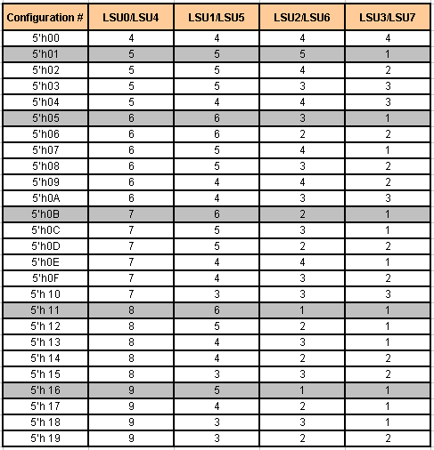
Shadow Register Pre-defined Combinations

Slide 16
LSU Registers
 | 31:0
LSU_Reg0 | RapidIO Destination Address MSB
LSU_Reg1 | RapidIO Destination Address LSB/Config_Offset
LSU_Reg2 | DSP Source Address
LSU_Reg3 | 31 |  |  |  |  |  |  | 30:20 |  |  |  |  | 19:0
 | Drbll_val |  |  |  |  |  |  | RSVD |  |  |  |  | Byte_Count
LSU_Reg4 | 31:16 | 15:12 |  |  | 11:10 |  | 9:8 |  | 7:4 |  | 3:2 |  | 1 |  | 0
 | DestID | SrcID_MAP |  |  | ID_Size |  | OutPortID |  | Priority |  | Xambs |  | Sup_gint |  | Int_Req
LSU_Reg5 | 31:16 |  |  |  |  |  | 15:8 |  |  | 7:4 |  | 3:0
 | Drbll_Info |  |  |  |  |  | Hop Count |  |  | FType |  | TType
LSU_Reg6 (RO) | 31 |  | 30 |  |  |  | 29:5 |  |  | 4 |  | 3:0
 | Busy |  | Full |  |  |  | RSVD |  |  | LCB |  | LTID
LSU_Reg6 (WO) | 31:28 |  |  | 27 |  | 26:6 |  |  |  | 5:2 |  | 1 |  | 0
 | PrivID |  |  | CBUSY |  | RSVD |  |  |  | SrcID_MAP |  | Restart |  | Flush
Doorbell Valid - Doorbell represented by Drbll_Info field will be sent out at the end of message.
Suppressing Interrupt for good completion and only generating for error condition
Identifies which DeviceID out of 16 Local DeviceIDs is to be used
For checking availability of Shadow Register
Context bit for verifying validity of completion code
LSU shadow register number
Clearing Busy Condition – In this example Core0 forgot to release the LSUx, then Core1 uses PrivID of Core0 and sets this bit.
Flush discards all shadow registers with SRCID errors.
Error response will halt the LSU. Restart will restart LSU from next shadow register.

Slide 17
Tx Operation: Non-EDMA Mode

Slide 18
Tx Operation: EDMA Mode
In this mode, the EDMA programs the shadow registers.
The LSUx_EDMA bit is available to program this mode in the SETUP register.
The EDMA programs LSU registers Reg0 to Reg5.
LSU sends the packet out and the completion generates an interrupt which triggers the EDMA once again.
The pre-requisite is that the LSU used by EDMA must not be used by any other master:
This eliminates the possibility that the LSU becomes busy by another master, so reading the busy bit is not required.
EDMA will be able to use only one shadow register so full-bit checking is also not required.
So LSU Reg6 read is not required for EDMA mode of operation.

Slide 19
Rx Operation: MAU
MAU issues four outstanding VBUSM transactions (write/read commands):
Those four cannot be (same SrcID) && (same DestID) && (same or lower priority).
One of these three requirements must not be matching
If packet is doorbell, then complete all outstanding transactions and post interrupt.
If another doorbell comes and previous doorbell is not complete, then a RETRY is attempted on that doorbell.
Packet Forwarding:
Incoming packet is moved to the MAU local buffer first.
The packet applies for credit. If it gets the credit, then it will be moved to shared buffer.
Forwarding traffic and local traffic mechanisms are separate to avoid conflicts.

Slide 20
Rx Operation: MAU Example
Incoming Data goes to Physical Layer Buffers in the same order.
MAU transfers data to the absolute address provided in the packet segments.
Round robin pickup from all four ports and then move to Shared Buffers.

Slide 21
Message Passing Operation
SRIO Overview
DirectIO Operation
Message Passing Operation
Other RapidIO Features
Summary

Slide 22
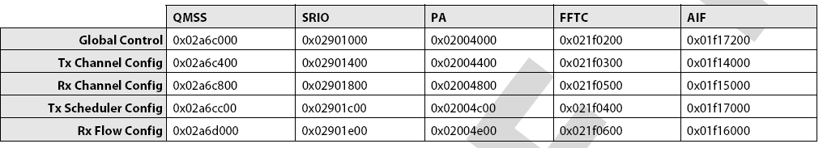
C66x Message Passing Operations Compared to C64x+
16 Transmit & 16 Receive Channels
20 Receive Flows
16 dedicated Tx queues for 16 Tx channels
Queues for 16 Rx channels are assigned from this range.

Slide 23
C66x Message Passing Operations Compared to C64x+
Maximum 4 KB message size
Maximum of 16 segments per message
64 receive mapping table entries / 32 in 64x+
16 outstanding multi-segment + single segment non-posted messages / 4 multi-segment & 12 single-segment in 64x+

Slide 24
Rx Protocol-Specific Part of Descriptor
All fields are same as previous devices. No extra fields have been added here.
Message size is not part of the SRIO-specific descriptor fields, but instead is located in one of the general descriptor words.
One Rx descriptor/buffer per Type 11 message

Slide 25
Rx Operation
CDMA pops descriptor from Free Descriptor Queue, each of which uses different size buffers. The CDMA chooses based on the message size.
4
RXU identifies Free Channel/Segmentation Context and sends data along with FlowID & Dest_QID to PKTDMA.
2
3
PKTDMA channel identifies Free Descriptor Queue from the FlowID received from SRIO.
1
RXU identifies SrcID, DestID, Letter & Mailbox from incoming packet and maps to FlowID and Dest_QID.
PKTDMA writes data to Destination Memory pointed to by Free Buffer Descriptor.
5
6
PKTDMA pushes used descriptor to Destination Queue.

Slide 26
Tx Protocol-Specific Part of Descriptor
All fields are same as previous devices. No extra fields have been added here.
Message size is not part of the SRIO-specific descriptor fields, but instead is located in one of the general descriptor words.
One Tx descriptor/buffer per message

Slide 27
TX Operation
3
Configure SRIO for linking Tx Channel/Queue with Output Port#
1
Prepare Tx descriptor after popping them from Free Descriptor Queue
Configure the Tx channel for Tx recycle Queue and Priority
2
7
As soon as TXU gets credit it reads packet data from Channel & writes to Tx Shared Buffers
6
TXU Requests Protocol Specific Descriptor Info (header) & asks Credit Manager to assign Credit, if it does not have credit then TXU will try another channel’s packet
4
Push Descriptor on Respective Tx Queue
5
Respective Channel will read Descriptor & Pull data from Memory

Slide 28
TXU Scheduling
TXU scheduling requires that a TX queue be dedicated to an outbound port and priority.
For example:
Two active channels/queues
One port 4X mode, so all queues are going to the same output port.
Queue 1 uses Priority 1 and has something to send.
Queue 2 uses Priority 1 + CRF bit and has something to send.
Queue 2 is scheduled first and starts to send packets.
During the 5th packet segment transfer when the TXU is moving data to the physical layer, TX buffer Queue 3 becomes active and has Priority 2.
When Queue 2 is done moving the 5th segment to the physical layer, TXU will begin reading the header info from Queue 3 and subsequently start sending packets from Queue 3.
Only after TXU finishes all of the message from Queue 3 will it attempt to go back and send the remaining packets from Queue 2, finally followed by Queue 1 if nothing else of higher priority has shown up in the meantime.

Slide 29
Other RapidIO Features
SRIO Overview
DirectIO Operation
Message Passing Operation
Other RapidIO Features
Summary

Slide 30
Interrupt Destinations
24 Interrupt Destinations (INTDST0 to INTDST23)
INTDST16 to INTDST23 are only for Doorbell interrupts
No Interrupt pacing on INTDST16 to INTDST23

Slide 31
Interrupt Registers
Three sets of registers route events to INTDSTx:
ICSR (Interrupt Condition Set Register)
ICCR (Interrupt Condition Clear Register)
ICRR (Interrupt Condition Routing Register)
Doorbell has one special register -- RIO_INTERRUPT_CTL -- which has DBLL_ROUTE bit to decide whether Doorbell ICRR represents (INTDST0 to INTDST15) OR (INTDST16 to INTDST23).
Doorbell events in Doorbell ICSR are same as previous devices.
Error events in Error ICSR is same as previous devices.
LSU events are referenced by SrcID (non-EDMA mode). As KeyStone has 16 local device ID registers, LSU events shows whether a transaction for a particular srcID is complete with Success or Error. Software controlled mapping of srcID error with a particular transaction from a particular LSU is required.
LSU events with respect to PrivID (EDMA mode)

Slide 32
SRIO LLD
DirectIO, Type 9 and Type 11 packets support
APIs With Sequence Of Operations
SRIO Peripheral Initialization – Srio_init ()
SRIO Driver Instance Initialization – Srio_start ()
Initialize Receive & Transmit memory regions for descriptors
Creates & Enables CDMA Channels & link them with respective queues
SRIO Socket Open – SRIO_sockOpen ()
Specify Packet Type
Blocking or Non-blocking during Rx Operation
Same way SRIO_sockClose ()
SRIO Socket Bind – SRIO_sockBind ()
Socket Bind is applying RXU mapping entries
So max sockets are max RXU mapping entries which is 64
Send API – SRIO_sockSend ()
Triggers Tx operation with input data pointer, input data size and Destination info (e.g. Mailbox, letter)
Receive API – SRIO_sockRecv ()
Triggers Rx operation with receive buffer pointer, receive socket

Slide 33
Summary
C66x SRIO has been enhanced to deliver:
Higher performance
New transaction types
Less required CPU interaction per transaction
Better deterministic scheduling
More flexibility and system support with increased number of IDs
For more information:
Serial RapidIO (SRIO) for KeyStone Devices User Guide
Support forums at the TI E2E Community website

